Slide 1
Javascript

Slide 2
Javascript
Javascript is a dynamic computer programming language.
JavaScript is a lightweight, interpreted programming language.
Designed for creating network-centric applications.
Complementary to and integrated with Java.
Complementary to and integrated with HTML.
Open and cross-platform.

Slide 3
Client-Side JavaScript
Client-side JavaScript is the most common form of the language.
The script should be included in or referenced by an HTML document for the code to be interpreted by the browser.
The JavaScript code is executed when the user submits the form.
If all the entries are valid, they would be submitted to the Web Server.
JavaScript can be used to trap user-initiated events such as button clicks, link navigation, and other actions that the user initiates explicitly or implicitly.

Slide 4
Advantages of JavaScript
Less server interaction: You can validate user input before sending the page off to the server. This saves server traffic, which means less load on your server.
Immediate feedback to the visitors: They don't have to wait for a page reload to see if they have forgotten to enter something.
Increased interactivity: You can create interfaces that react when the user hovers over them with a mouse or activates them via the keyboard.
Richer interfaces: You can use JavaScript to include such items as drag-anddrop components and sliders to give a Rich Interface to your site visitors.

Slide 5
Limitations of JavaScript
Client-side JavaScript does not allow the reading or writing of files. This has been kept for security reason.
JavaScript cannot be used for networking applications because there is no such support available.
JavaScript doesn't have any multithreading or multiprocessor capabilities.

Slide 6
JavaScript Development Tools
Microsoft FrontPage:
Macromedia Dreamweaver MX: Macromedia Dreamweaver MX is a very popular HTML and JavaScript editor in the professional
web development crowd. It provides several handy prebuilt JavaScript components, integrates well with databases, and conforms to new standards such as XHTML and XML.
Macromedia HomeSite 5: HomeSite 5 is a well-liked HTML and JavaScript editor from Macromedia that can be used to manage personal websites effectively.

Slide 7
JAVASCRIPT – SYNTAX
JavaScript can be implemented using JavaScript statements that are placed within the HTML tags in a web page.
The <script> tag alerts the browser program to start interpreting all the text between these tags as a script.
The script tag takes two important attributes:
Language: This attribute specifies what scripting language you are using. Typically, its value will be javascript. Although recent versions of HTML (and XHTML, its successor) have phased out the use of this attribute.
Type: This attribute is what is now recommended to indicate the scripting language in use and its value should be set to "text/javascript".

Slide 8
Whitespace and Line Breaks
JavaScript ignores spaces, tabs, and newlines that appear in JavaScript programs.
Programs in a neat and consistent way that makes the code easy to read and understand.
Simple statements in JavaScript are generally followed by a semicolon character, just as they are in C, C++, and Java.
JavaScript, however, allows you to omit this semicolon if each of your statements are placed on a separate line.
<script language=“javascript” type=“text/javascript”>
<!--
var1 = 10
var2 = 20
// -- >
</script>

Slide 9
Case Sensitivity
JavaScript is a case-sensitive language.
This means that the language keywords, variables, function names, and any other identifiers must always be typed with a consistent capitalization of letters.
So the identifiers Time and TIME will convey different meanings in JavaScript.
Comments in JavaScript :
JavaScript supports both C-style and C++-style comments. Thus:
Any text between a // and the end of a line is treated as a comment and is ignored by JavaScript.
Any text between the characters /* and */ is treated as a comment. This may span multiple lines.
JavaScript also recognizes the HTML comment opening sequence is not recognized by JavaScript so it should be written as //-->.
The HTML comment closing sequence --> is not recognized by JavaScript so it should be written as //-->.

Slide 10
JAVASCRIPT-PLACEMENT
The most preferred ways to include JavaScript in an HTML file are as follows:
Script in <head>... </head> section.
Script in <body>... </body> section.
Script in <body>... </body> section and Script in <head>... </head> sections.
Script in an external file and then include in <head> …</head> section.
Reusing identical JavaScript code on multiple pages of a site.
The script tag provides a mechanism to allow you to store JavaScript in an external file and then include it into your HTML files.

Slide 11
Javascript-Variables
JavaScript Datatypes
JavaScript allows you to work with three primitive data types:
Numbers, e.g., 123, 120.50 etc.
Strings of text, e.g. "This text string" etc.
Boolean, e.g. true or false.
JavaScript also defines two trivial data types, null and undefined, each of which defines only a single value.
JavaScript also supports a composite data type known as object.

Slide 12
JavaScript Variables
Variables can be thought of as named containers.
Data into these containers and then refer to the data simply by naming the container.
Variables are declared with the var keyword as follows.
JavaScript Variable Scope
Global Variables: A global variable has global scope which means it can be defined anywhere in your JavaScript code.
Local Variables: A local variable will be visible only within a function where it is defined. Function parameters are always local to that function.

Slide 13
JavaScript Operators
Let us take a simple expression 4 + 5 is equal to 9.
Here 4 and 5 are called operands and ‘+’ is called the operator.
JavaScript supports the following types of operators.
Arithmetic Operators
Comparison Operators
Logical (or Relational) Operators
Assignment Operators
Conditional (or ternary) Operators

Slide 14
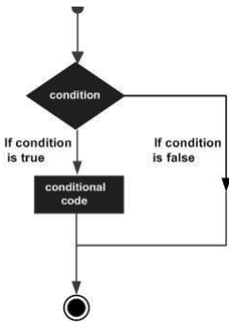
Javascript Control Statements
While writing a program, there may be a situation when you need to adopt one out of a given set of paths.
JavaScript supports conditional statements which are used to perform different actions based on different conditions.
Flow Chart of if-else The following flow chart shows how the if-else statement works.
JavaScript supports the following forms of if..else statement
if statement
if...else statement
if...else if... statement.

Slide 15
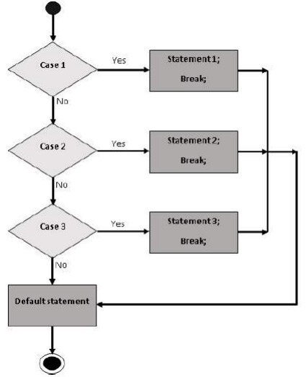
Javascript- Switch Case
Multiple if...else…if statements, as in the previous chapter, to perform a multiway branch.

Slide 16
Javascript- While Loops and Do-While Loops
While writing a program, you may encounter a situation where you need to perform an action over and over again.
The while Loop
The most basic loop in JavaScript is the while loop.
The purpose of a while loop is to execute a statement or code block repeatedly as long as an expression is true.
The do...while loop is similar to the while loop except that the condition check happens at the end of the loop.
do{ Statement(s) to be executed; } while (expression);

Slide 17
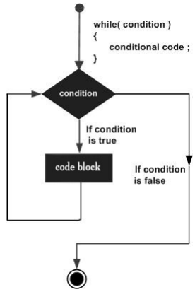
Flow Chart
The flow chart of while loop looks as follows −

Slide 18
Javascript- For Loop
The 'for' loop is the most compact form of looping. It includes the following three important parts.
The loop initialization where we initialize our counter to a starting value. The initialization statement is executed before the loop begins.
The test statement which will test if a given condition is true or not. If the condition is true, then the code given inside the loop will be executed, otherwise the control will come out of the loop.
The iteration statement where you can increase or decrease your counter.
for (initialization; test condition; iteration statement){ Statement(s) to be executed if test condition is true }

Slide 19
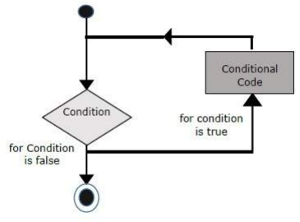
Flow Chart
The flow chart of a for loop in JavaScript would be as follows:-

Slide 20
Javascript – Loop Control
JavaScript provides full control to handle loops and switch statements.
There may be a situation when you need to come out of a loop without reaching at its bottom.
There may also be a situation when you want to skip a part of your code block and start the next iteration of the look.
To handle all such situations, JavaScript provides break and continue statements.

Slide 21
Using Labels to Control the Flow
A label can be used with break and continue to control the flow more precisely.
A label is simply an identifier followed by a colon (:) that is applied to a statement or a block of code.
Line breaks are not allowed between the ‘continue’ or ‘break’ statement and its label name.

Slide 22
Javascript- Functions
A function is a group of reusable code which can be called anywhere in your program.
This eliminates the need of writing the same code again and again.
It helps programmers in writing modular codes.
Functions allow a programmer to divide a big program into a number of small and manageable functions.
JavaScript also supports all the features necessary to write modular code using functions.
The most common way to define a function in JavaScript is by using the function keyword.
It is followed by a unique function name, a list of parameters (that might be empty), and a statement block surrounded by curly braces.
The return Statement: A JavaScript function can have an optional return statement
This statement should be the last statement in a function.

Slide 23
Javascript Events
JavaScript's interaction with HTML is handled through events that occur when the user or the browser manipulates a page.
When the page loads, it is called an event. When the user clicks a button, that click too is an event.
Other examples include events like pressing any key, closing a window, resizing a window, etc.
Developers can use these events to execute JavaScript coded responses.
It cause buttons to close windows, messages to be displayed to users, data to be validated, and virtually any other type of response imaginable.
Events are a part of the Document Object Model (DOM) Level 3 and every HTML element contains a set of events which can trigger JavaScript Code.

Slide 24
onclick Event Type
This is the most frequently used event type which occurs when a user clicks the left button of his mouse.
onsubmit is an event that occurs when you try to submit a form. You can put your form validation against this event type.
If validate() function returns true, the form will be submitted, otherwise it will not submit the data.
onsubmit is an event that occurs when you try to submit a form. You can put your form validation against this event type.
The onmouseover event triggers when you bring your mouse over any element and the onmouseout triggers when you move your mouse out from that element.

Slide 25
HTML Events 5
Attribute Value Description
Offline script Triggers when the document goes offline
Onabort script Triggers on an abort event
onafterprint script Triggers after the document is printed
onbeforeonload script Triggers before the document loads
onbeforeprint script Triggers before the document is printed
onblur script Triggers when the window loses focus
oncanplay script Triggers when media can start play, but might has to stop for buffering
oncanplaythrough script Triggers when media can be played to the end, without stopping for buffering
onchange script Triggers when an element changes
onclick script Triggers on a mouse click
oncontextmenu script Triggers when a context menu is triggered
ondblclick script Triggers on a mouse double-click
ondrag script Triggers when an element is dragged
ondragend script Triggers at the end of a drag operation

Slide 26
Javascript Form Validate
Form validation normally used to occur at the server, after the client had entered all the necessary data and then pressed the Submit button.
If the data entered by a client was incorrect or was simply missing, the server would have to send all the data back to the client and request that the form be resubmitted with correct information.
JavaScript provides a way to validate form's data on the client's computer before sending it to the web server.
Basic Validation − First of all, the form must be checked to make sure all the mandatory fields are filled in. It would require just a loop through each field in the form and check for data.
Data Format Validation − Secondly, the data that is entered must be checked for correct form and value. Your code must include appropriate logic to test correctness of data.

